Slide 1
BIS 403 - Applied Systems Design College: Peirce College Professor: Robert Heubner Group Members: J. Sherif & M. Morrison Case Study: Personal Trainer Case Study #5
Date: 1/30/2024
Tasks 1&2, completed by Jilalo Sherif
Tasks 3&4, completed by Morrese Morrison

Slide 2
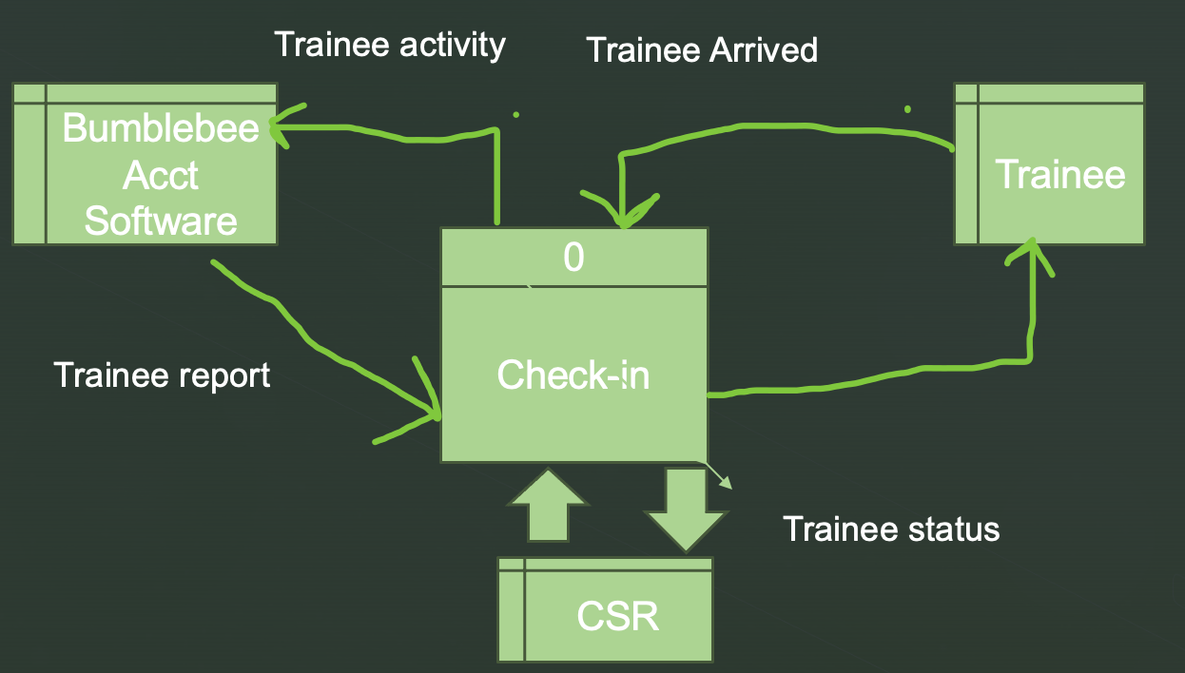
Personal Trainer Context Diagram - Task # 1

Slide 3
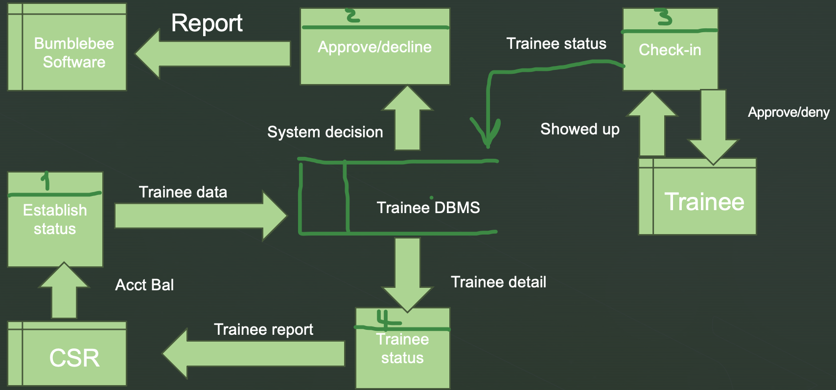
Personal Trainer Diagram 0 DFD Task #2

Slide 4
BumbleBee Software Corporate Reporting Attributes (Memo)
DATE: 1/30/2024
TO: Project Stakeholders
FROM: Susan Park
SUBJECT: Bumblebee Software Corporate Reporting Attributes
Greetings Stakeholders,
This memo is to list and standardized the current attributes that should utilized for the three corporate reports that is ran by headquarters. These reports are monthly member sales report, the exception report (Inactive & Late Payment Members), and the quarterly profit / loss report. Listed below are the attributes that should be utilized for each report.
Monthly Member Sales Report
Member ID Number - To identify who the member is. This attribute will be crossed referenced with a name when the report is generated.
Personal Trainer Facility ID Number - To determine the facility of origin. This provides insight on facility performance.
Membership Type - Provides insight on the highest selling membership type.
Membership Fee - Provides a total amount on their membership fee which is based off of their membership type.
Exception Report (Inactive & Late Payment Members)
Member ID Number - To identify who the member is. This attribute will be crossed referenced with a name when the report is generated.
Personal Trainer Facility ID Number - To determine the facility of origin. This provides insight on facility performance.
Days Inactive - Shows how many days a member may be inactive.
Days Past Due - Shows how many days a member is past due on their membership payment.
Days Past Due Total Fee - Shows how much a member owes in order to get their account reinstated and back active. This depends on their membership type.
Quarterly Profit / Loss Report
Personal Trainer Facility ID Number - To identify who the member is. This attribute will be crossed referenced with a name when the report is generated.
Personal Trainer Facility Lead Manager Number - To identity the lead manager that is in charge of a designated facility.
Total Revenue - Identifies the total revenue generated for a location. This includes membership sales, merchandise sales as well as service sales.
Total Expense - Identifies the total expense for a location. This includes facility rent, utilities, and overhead.
Total Profit - Identifies the the total profit generated for a location. Revenue minus all expenses at that location.
Merchandise Sales Total - Identifies total merchandise sales for a specific location.
Service Sales Total - Identifies total service sales for a specific location.

Slide 5
BumbleBee Software Entity Attributes (Memo)
DATE: 1/30/2024
TO: Project Stakeholders
FROM: Susan Park
SUBJECT: Bumblebee Software Entity Attributes
Greetings Stakeholders,
This memo is to list and standardized the current attributes that should utilized for entities that interact with the BumbleBee Software system directly or indirectly. Think of an entity as something that has some form of data associated with it and can affect the system. An example of this would be a Personal Trainer member. That member would be an entity because that individual has data related to them. Their age and sex for example. Listed below are two of the various entities as well as their attributes that will interact with the Bumble Bee software.
Personal Trainer Member
Member ID Number - To identify who the member is. This number is unique. Even if a member is inactive and is reinstated, they will their original member id number.
First Name - To identify the first name of the member.
Middle Name - To identity the middle name of the member. This also helps distinguish between members who may have the first and last name.
Last Name - To identify the last name of the member.
Age - To identify the age of the member. This plays a factor in service promotions.
Address - To identify the address of the member, for distinguishing purposes.
State - To identify the address of the member, for distinguishing purposes.
Zip Code - To identify the address of the member, for distinguishing purposes.
City - To identify the address of the member, for distinguishing purposes.
Email - For promotional purposes as well as account authentication, sign in, and communication.
Membership Type - Determines the level of membership the member has when utilizing the facility.
Personal Trainer Local Facility Manager
Personal Trainer Work ID Number - To identify who the Personal Trainer team member is. This number is unique throughout the organization.
Personal Trainer Facility ID Number - To determine what facility the manager manages. Each manager may only manage one facility. One to one relationship.
AD Username - For active directory sign on purposes.
Work Email - For company communication purposes.
First Name - To identify the first name of the employee.
Middle Name - To identity the middle name of the employee. This also helps distinguish between employees who may have the first and last name.
Last Name - To identify the last name of the employee.
Tenure - Identifies the seniority of the employee. Based on hire date.

